Slide 1


Sensory-Motor Integration in HTM Theory
Numenta
Catalyst for machine intelligence
San Jose Meetup 3/14/14
Jeff Hawkins
jhawkins@Numenta.com
Research Theory, Algorithms
NuPIC Open source community
Products for streaming analytics
Based on cortical algorithms
Notes:
I assume some knowledge of SDRs and CLA
This talk is more speculative than most

Slide 2
What is the Problem?
Sensory-motor integration
Sensorimotor contingencies
Embodied A.I.
Symbol grounding
Most changes in sensor data are due to our own actions.
Our model of the world is a “sensory-motor model”
1) How does the cortex learn this sensory-motor model?
2) How does the cortex generate behavior?

Slide 3
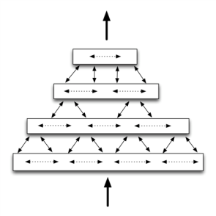
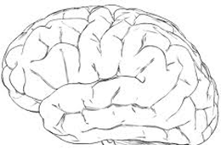
Hierarchical Temporal Memory (Review)
1) Hierarchy of nearly identical regions
- across species
- across modalities
retina
data stream
cochlea
somatic
2) Regions are mostly sequence memory
- inference
- motor
3) Feedforward: Temporal stability - inference - the world seems stable
Feedback: Unfold sequences
- motor/prediction

Slide 4
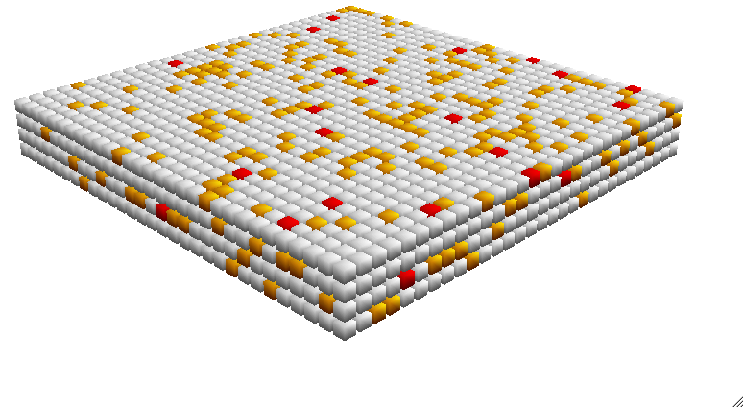
Cortical Learning Algorithm (Review)
A Model of a Layer of Cells in Cortex
Sequence Memory
- Converts input to sparse representations
- Learns sequences
- Makes predictions and detects anomalies
Capabilities - On-line learning
- Large capacity
- High-order
- Simple local learning rules
- Fault tolerant

Slide 5
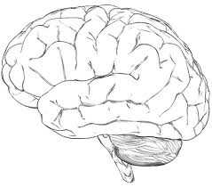
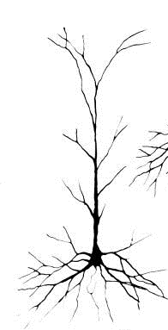
Cortex and Behavior (The big picture)
retina
cochlea
Old brain has complex behaviors.
Cortex evolved “on top” of old brain.
Cortex receives both sensory data and copies of motor commands.
- It has the information needed for sensory-motor inference.
Cortex learns to “control” old brain (via associative linking).
- It has the connections needed to generate goal-oriented behavior.
somatic
vestibular
sensory data
proprioceptive
motor copy
muscles
Old brain
- spinal cord - brain stem - basal ganglia

Slide 6
Region
2.5 mm
2/3
Layers
4
5
6
2/3
Sequence memory
Layers &
Mini-columns
4
Sequence memory
5
Sequence memory
6
Sequence memory
The cellular layer is unit of cortical computation.
Each layer implements a variant of the CLA.
Mini-columns play critical role in how layers learn sequences.

Slide 7
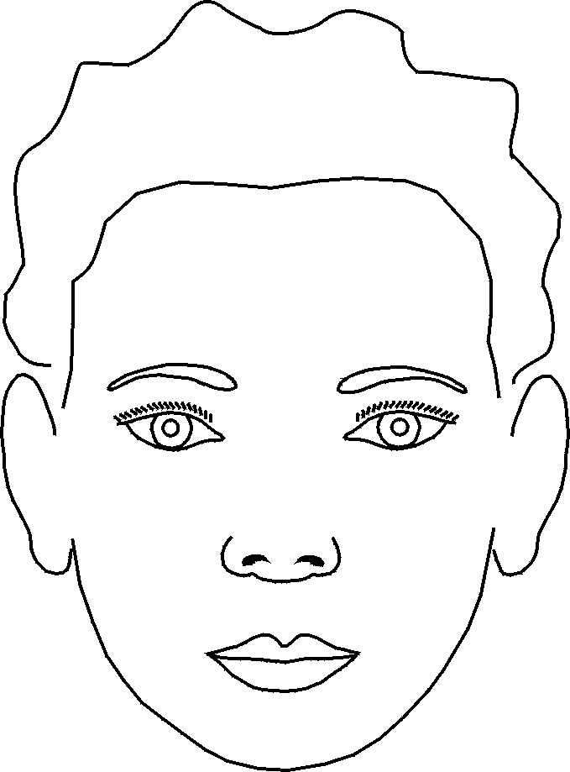
L4 and L2/3: Feedforward Inference
2/3
Learns high-order sequences
Stable
Unique
Predicted
Pass through
changes
Un-predicted
A-B-C-D X-B-C-Y
A-B-C- ? D X-B-C- ? Y
4
Learns sensory-motor transitions
5
6
Sensor/afferent data
Next higher region
Copy of motor commands
Layer 4 learns changes in input due to behavior.
Layer 3 learns sequences of L4 remainders.
These are universal inference steps.
They apply to all sensory modalities.

Slide 8
L5 and L6: Feedback, Behavior and Attention
2/3
Learns high-order sequences
Well understood (CLA)
tested / commercial
Feedforward
4
Learns sensory-motor transitions
90% understood
testing in progress
5
Recalls motor sequences
50% understood
Feedback
6
Attention
10% understood
Old brain

Slide 9
L3: Existing CLA Learns High-order Sequences
2/3
Learns high-order sequences
4
Learns sensory-motor transitions
5
Recalls motor sequences
6
Attention

Slide 10
L4: CLA With Motor Command Input Learns Sensory-motor Transitions
2/3
Learns high-order sequences
4
Learns sensory-motor transitions
5
Recalls motor sequences
6
Attention
Sensor/afferent data
Copy of motor commands

Slide 13
+W
+SE
+N
+SW
+NE
With motor context, CLA will form unique representations.
+E
+NW
+S
+NE
+SW
With motor context, CLA will form unique representations.

Slide 14
How Does L5 Generate Motor Commands?
2/3
Learns high-order sequences
4
Learns sensory-motor transitions
5
Recalls motor sequences
6
Attention
Old brain

Slide 15
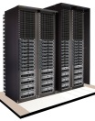
One extreme: Dynamic world no behavior
CLA, high-order sequence memory
sensory encoder
Grok: Detects Anomalies In Servers

Slide 16
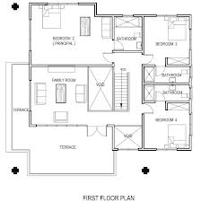
Other extreme: Static world
Behavior is needed for any change in sensory stream
Move sensor: saccade, turn head, walk
Interact with world: push, lift, open, talk

Slide 17
Review: Mammals have pre-wired, sub-cortical behaviors
Body + old brain
Pre-wired behavior generators
walking running eye movements head turning grasping reaching breathing blinking, etc.

Slide 18
Review: Cortex models behavior of body and old brain
Body + old brain
Cortex (CLA)
Pre-wired behavior generators
Cortex learns sensory patterns.
Cortex also learns sensory-motor patterns.
Makes much better predictions knowing behavior.

Slide 19
How does cortex control behavior?
Body + old brain
L4/L3
Pre-wired behavior generators
L5
L4/L3 is a sensory-motor model of the world
L3 projects to L5 and they share column activations
Think of L5 as a copy of L3
L5 associatively links to sub-cortical behavior
Cortex can now invoke behaviors
Q. Why L5 in addition to L3?
A. To separate inference from behavior.
- Inference: L4/L3 (L3->L5->old brain learns associative link)
- Behavior: L5 (L5 generates behavior before feedforward inference)

Slide 20
Cortical Hierarchy
L4/L3
slower changing
L5
Increasing invariance
L6
faster changing
L4/L3
Body + old brain
Stable feedback
L5
L6
Copy of motor command
L3/L4
Sub-cortical behavior generator
L5
Each cortical region treats the region below it in the hierarchy as the first region treats the pre-wired areas.

Slide 21
Goal Oriented Behavior via Feedback
Stable/Invariant pattern from higher region
Higher region
2/3
complex cells
4
simple cells
Copy of motor command
5
complex cells
6
simple cells
Sensor/afferent data
Copy of motor commands
Sub-cortical
motor
Stable feedback invokes union of sparse states in multiple sequences. (“Goal”)
Feedforward input selects one state and plays back motor sequence from there.

Slide 22
Short term goal: Build a one region sensorimotor system
Body + old brain
L4/L3
Pre-wired behavior generators
L5
Hypothesis:
The only way to build machines with intelligent goal oriented behavior is to use the same principles as the neocortex.

Slide 23
Notes:
Matt

Slide 24
retina
cochlea
somatic
sensory data
vestibular
proprioceptive
Old brain behaviors
Cortex 2
Cortex 1
Basal ganglia
Brainstem
Spine

Slide 25
f3
f4
f2
f1
A

Slide 26
Cortical Principles
1) On-line learning from streaming data
retina
data stream
cochlea
somatic

Slide 27
Cortical Principles
1) On-line learning from streaming data
2) Hierarchy of memory regions
retina
data stream
cochlea
somatic

Slide 28
Cortical Principles
1) On-line learning from streaming data
2) Hierarchy of memory regions
3) Sequence memory
- inference
- motor
retina
data stream
cochlea
somatic

Slide 29
Cortical Principles
1) On-line learning from streaming data
2) Hierarchy of memory regions
3) Sequence memory
retina
data stream
cochlea
4) Sparse Distributed Representations
somatic

Slide 30
Cortical Principles
1) On-line learning from streaming data
2) Hierarchy of memory regions
3) Sequence memory
retina
data stream
cochlea
4) Sparse Distributed Representations
somatic
5) All regions are sensory and motor
Motor

Slide 31
Cortical Principles
1) On-line learning from streaming data
2) Hierarchy of memory regions
x
x
x
3) Sequence memory
retina
data stream
x
x
x
x
cochlea
4) Sparse Distributed Representations
x
x
x
x
x
x
somatic
5) All regions are sensory and motor
6) Attention

Slide 32
Cortical Principles
1) On-line learning from streaming data
2) Hierarchy of memory regions
3) Sequence memory
retina
data stream
cochlea
4) Sparse Distributed Representations
somatic
5) All regions are sensory and motor
6) Attention
These six principles are necessary and sufficient for biological and machine intelligence.

Slide 33
What the Cortex Does
retina
The neocortex learns a model from sensory data
- predictions - anomalies - actions
data stream
cochlea
somatic
The neocortex learns a sensory-motor model of the world

Slide 34
Attributes of Solution
Independent of sensory modality and motor modality
Should work with biological and non-biological senses
Biological: Vision, audition, touch, proprioception
Non-biological: M2M data, IT data, financial data, etc.
Can be understood in a single region
Must work in a hierarchy
Will be based on CLA principles

Slide 35
How does a layer of neurons learn sequences?
2/3
Learns high-order sequences
4
5
6
First:
- Sparse Distributed Representations
- Neurons

Slide 36
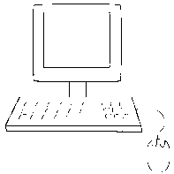

Dense Representations
Few bits (8 to 128)
All combinations of 1’s and 0’s
Example: 8 bit ASCII
Bits have no inherent meaning Arbitrarily assigned by programmer
01101101 = m
Sparse Distributed Representations (SDRs)
Many bits (thousands)
Few 1’s mostly 0’s
Example: 2,000 bits, 2% active
Each bit has semantic meaning Learned
01000000000000000001000000000000000000000000000000000010000…………01000

Slide 37
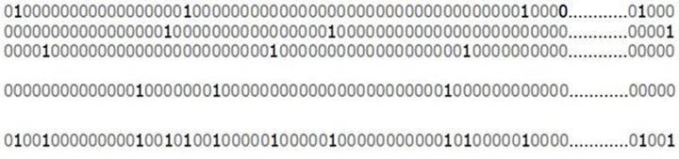
SDR Properties
1) Similarity: shared bits = semantic similarity
2) Store and Compare: store indices of active bits
Indices 1 2 3 4 5 | 40
subsampling is OK
Indices 1 2 | 10
3) Union membership:
1) 2) 3)
2%
….
10)
Union
20%
Is this SDR a member?

Slide 38
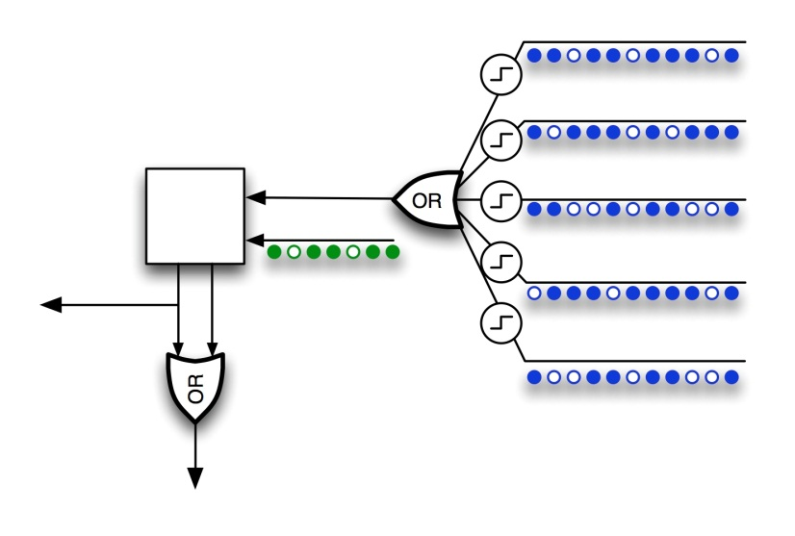
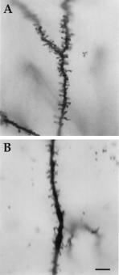
Neurons
Active Dendrites
Pattern detectors
Each cell can recognize
100’s of unique patterns
Feedforward
100’s of synapses
“Classic” receptive field
Model neuron
Context
1,000’s of synapses
Depolarize neuron
“Predicted state”

Slide 39
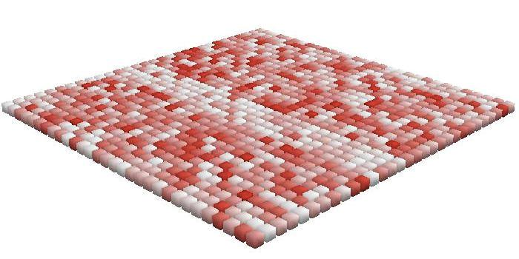
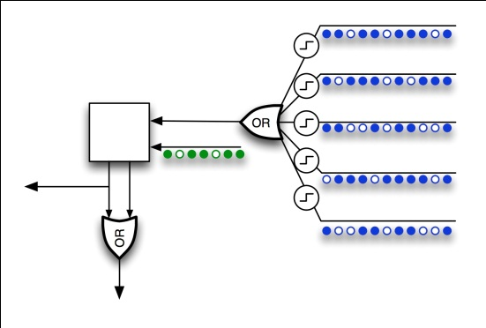
Learning Transitions
Feedforward activation

Slide 40
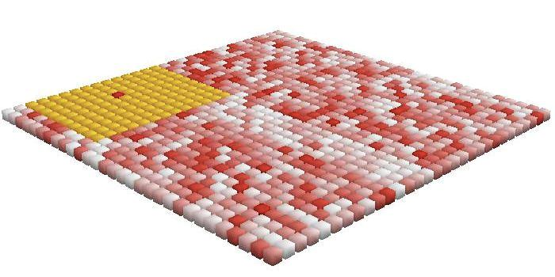
Learning Transitions
Inhibition

Slide 41
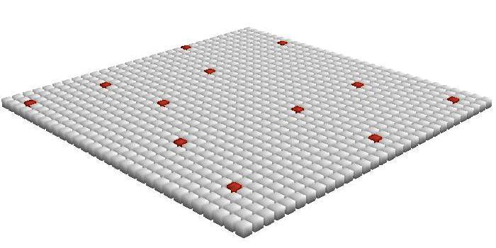
Learning Transitions
Sparse cell activation

Slide 42
Time = 1
Learning Transitions

Slide 43
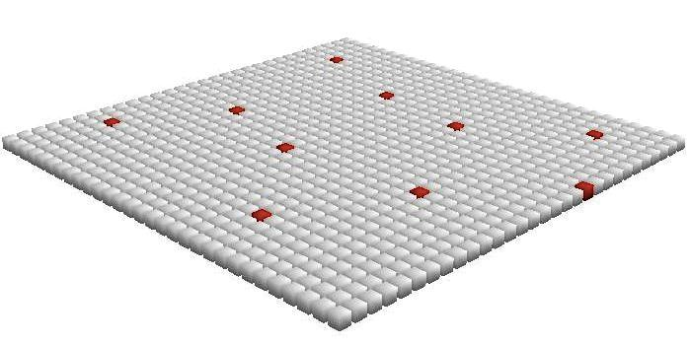
Time = 2
Learning Transitions

Slide 44
Learning Transitions
Form connections to previously active cells.
Predict future activity.

Slide 45
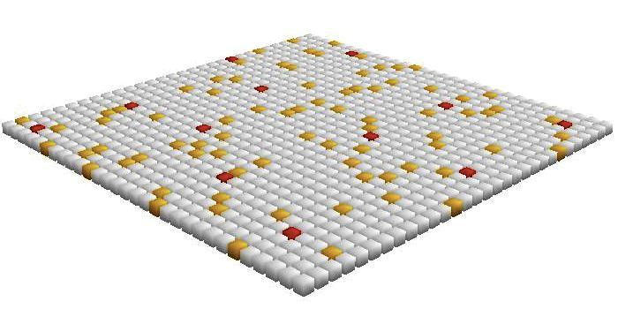
Learning Transitions
Multiple predictions can occur at once.
A-B A-C A-D
This is a first order sequence memory.
It cannot learn A-B-C-D vs. X-B-C-Y.

Slide 46
High-order Sequences Require Mini-columns
A-B-C-D vs. X-B-C-Y
X
B’’
C’’
Y’’
A
B’
C’
Before training
X
B
C
Y
A
B
C
D

Slide 47
Cortical Learning Algorithm (CLA)
aka Cellular Layer
Converts input to sparse representations in columns
Learns transitions
Makes predictions and detects anomalies
Applications 1) High-order sequence inference L2/3
2) Sensory-motor inference L4
3) Motor sequence recall L5
Capabilities - On-line learning
- High capacity
- Simple local learning rules
- Fault tolerant
- No sensitive parameters
Basic building block of neocortex/Machine Intelligence

Slide 48
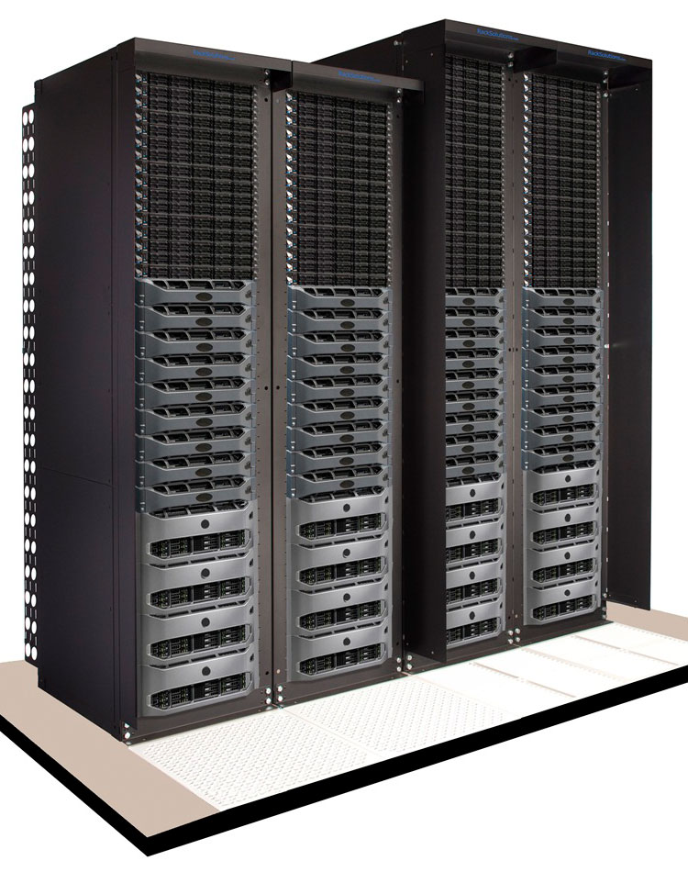
Anomaly Detection Using CLA
CLA
Prediction
Point anomaly
Time average
Historical comparison
Anomaly score
Metric(s)
Encoder
SDR
. . .
System Anomaly Score
CLA
Prediction
Point anomaly
Time average
Historical comparison
Anomaly score
Metric N
Encoder
SDR
SDR

Slide 49
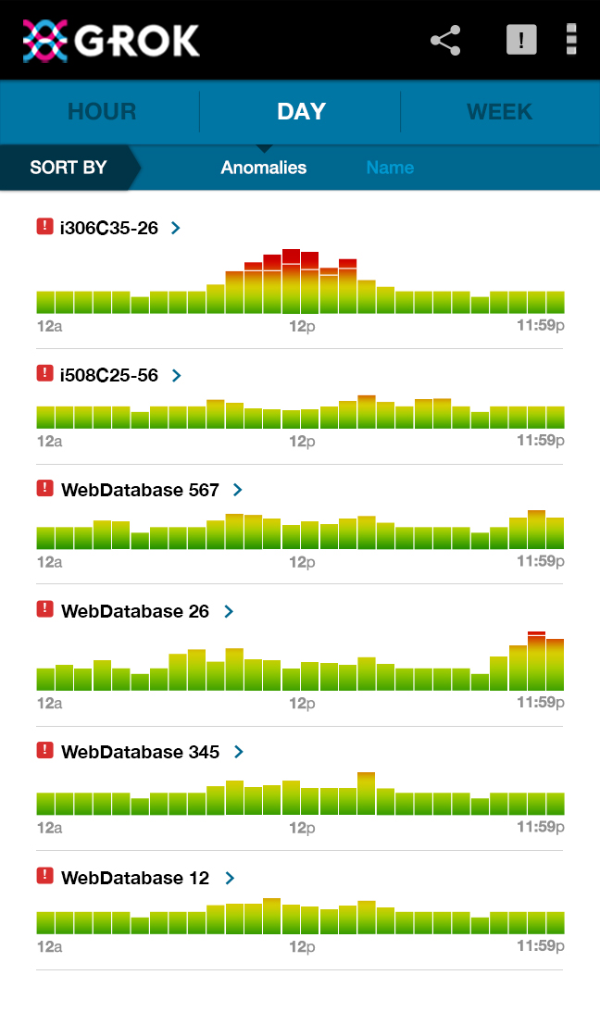
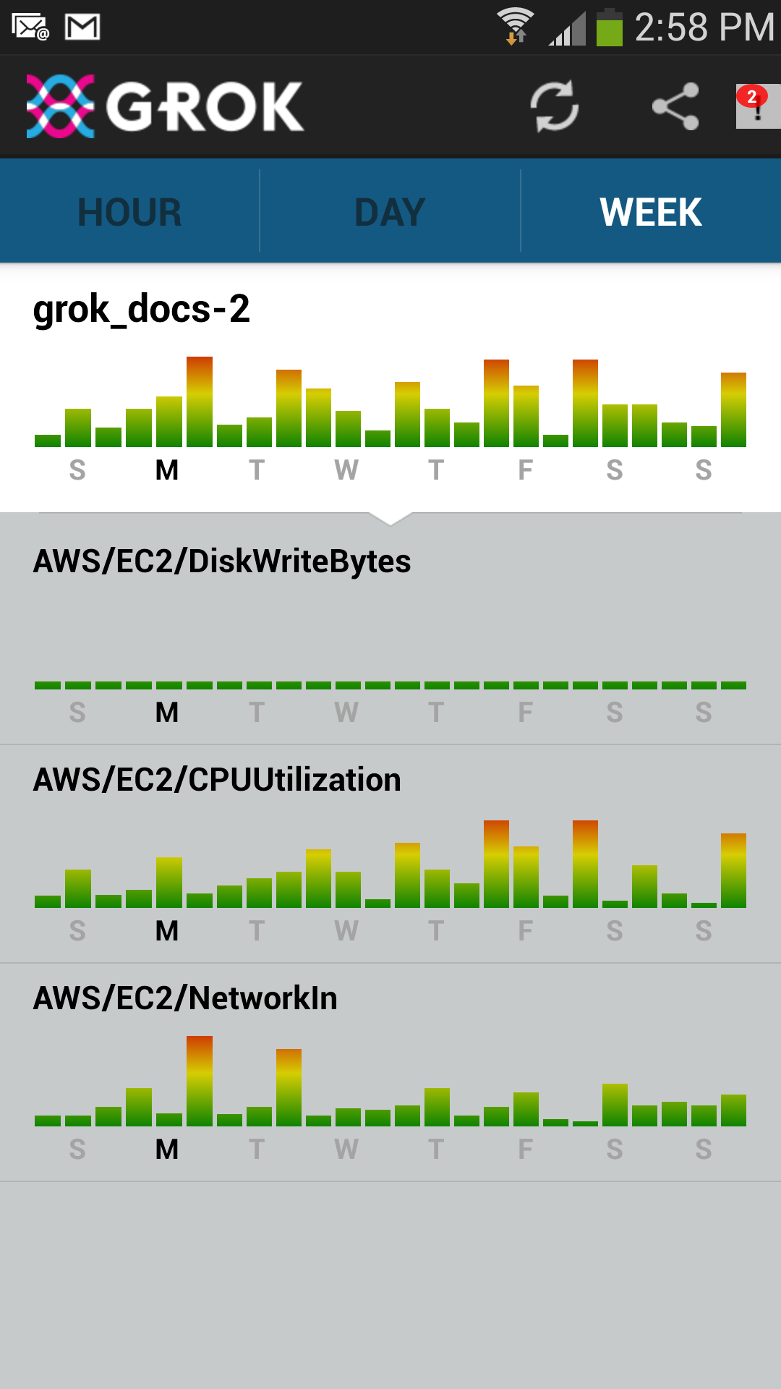
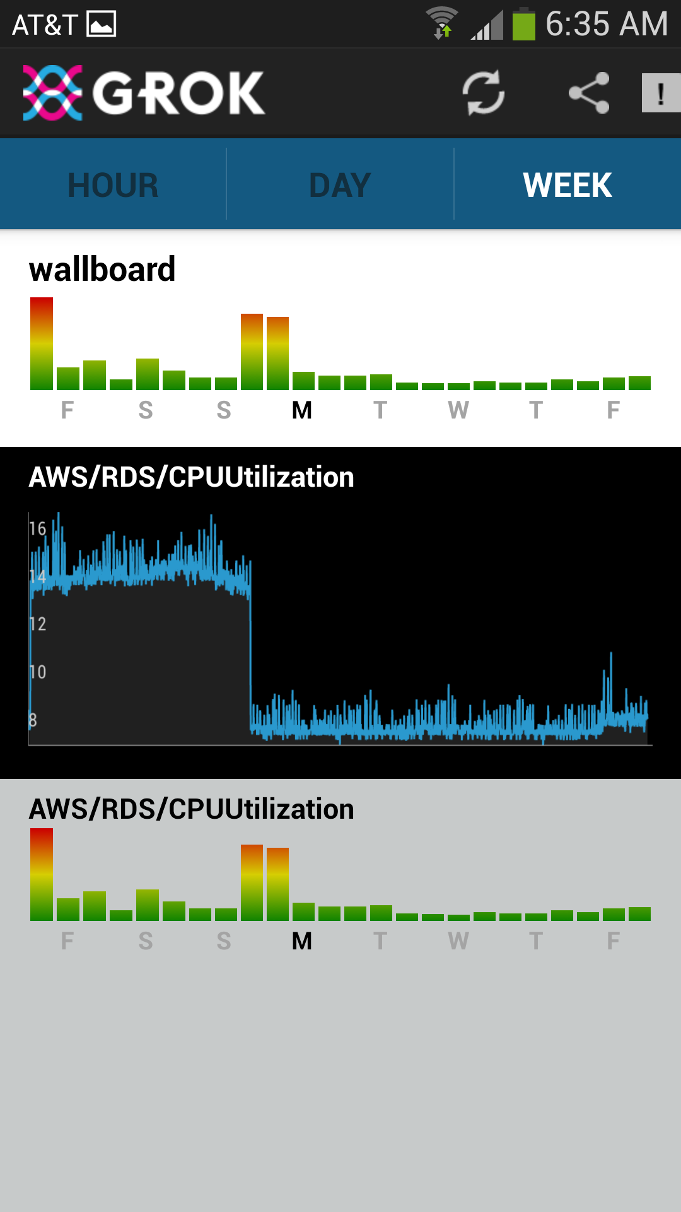
Grok for Amazon AWS
“Breakthrough Science for Anomaly Detection”
Automated model creation
Ranks anomalous instances
Continuously updated
Continuously learning

Slide 50
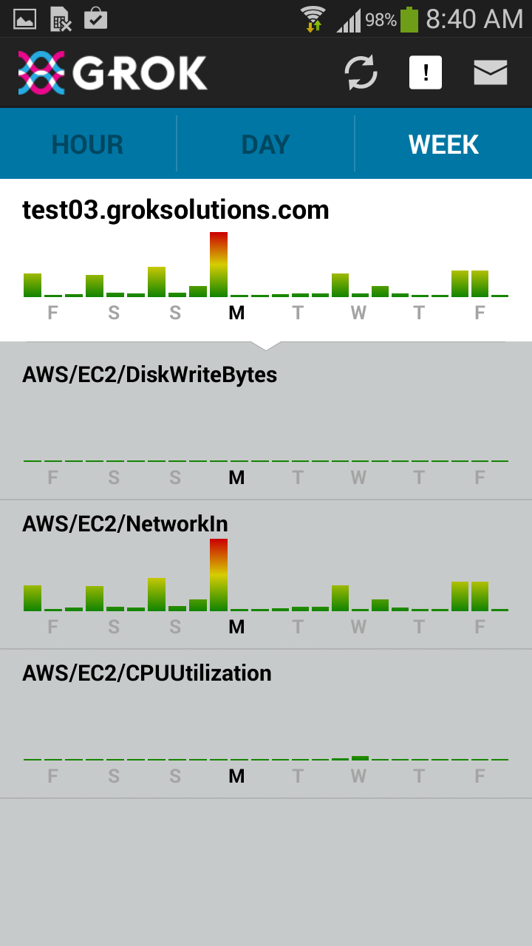
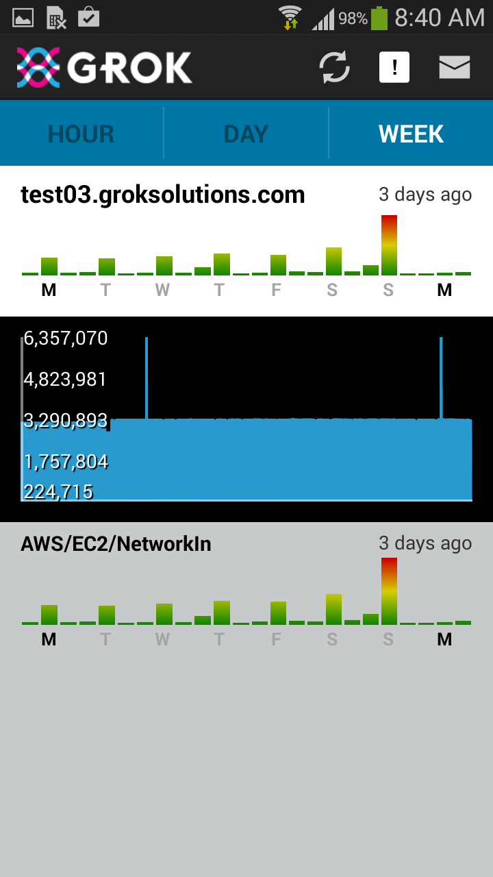
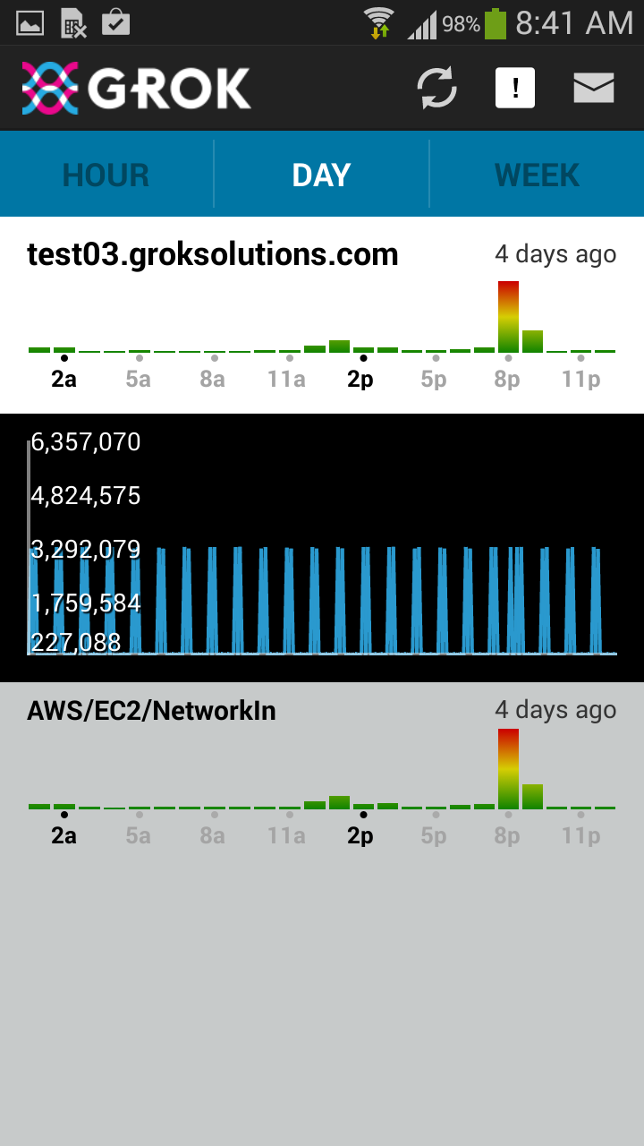
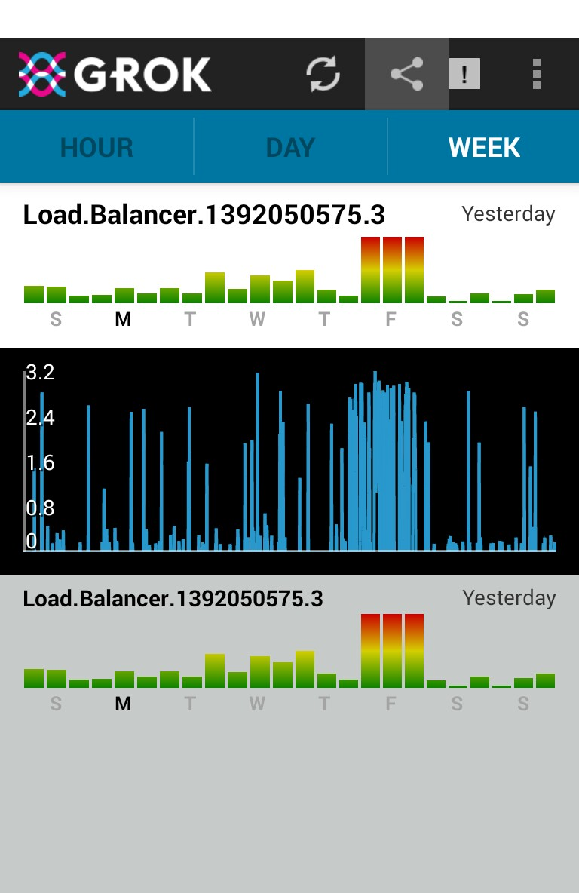
Unique Value of Cortical Algorithms
Technology can be applied to any kind of data, financial, manufacturing, web sales, etc.

Slide 51
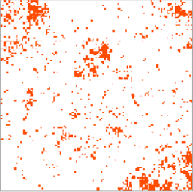
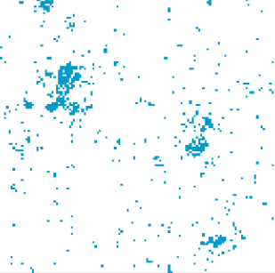
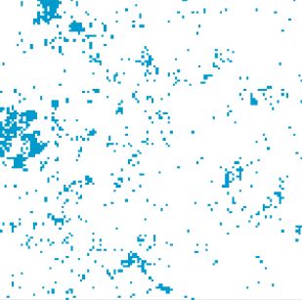
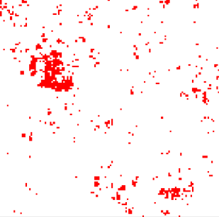
Application: CEPT Systems
100K “Word SDRs”
Document corpus (e.g. Wikipedia)
128 x 128
Apple
-
Fruit
Computer
Macintosh
Microsoft
Mac
Linux
Operating system
….
=

Slide 52
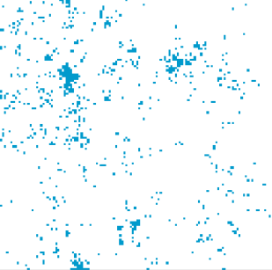
Sequences of Word SDRs
Training set
frog | eats | flies
cow | eats | grain
elephant | eats | leaves
goat | eats | grass
wolf | eats | rabbit
cat | likes | ball
elephant | likes | water
sheep | eats | grass
cat | eats | salmon
wolf | eats | mice
lion | eats | cow
dog | likes | sleep
elephant | likes | water
cat | likes | ball
coyote | eats | rodent
coyote | eats | rabbit
wolf | eats | squirrel
dog | likes | sleep
cat | likes | ball
---- | ---- | -----
Word 1
Word 2
Word 3

Slide 53
Sequences of Word SDRs
Training set
frog | eats | flies
cow | eats | grain
elephant | eats | leaves
goat | eats | grass
wolf | eats | rabbit
cat | likes | ball
elephant | likes | water
sheep | eats | grass
cat | eats | salmon
wolf | eats | mice
lion | eats | cow
dog | likes | sleep
elephant | likes | water
cat | likes | ball
coyote | eats | rodent
coyote | eats | rabbit
wolf | eats | squirrel
dog | likes | sleep
cat | likes | ball
---- | ---- | -----
“fox”
eats
?

Slide 54
Sequences of Word SDRs
Training set
frog | eats | flies
cow | eats | grain
elephant | eats | leaves
goat | eats | grass
wolf | eats | rabbit
cat | likes | ball
elephant | likes | water
sheep | eats | grass
cat | eats | salmon
wolf | eats | mice
lion | eats | cow
dog | likes | sleep
elephant | likes | water
cat | likes | ball
coyote | eats | rodent
coyote | eats | rabbit
wolf | eats | squirrel
dog | likes | sleep
cat | likes | ball
---- | ---- | -----
“fox”
eats
rodent
Word SDRs created unsupervised
Semantic generalization SDR: lexical CLA: grammatic
Commercial applications Sentiment analysis Abstraction Improved text to speech Dialog, Reporting, etc. www.Cept.at

Slide 55
Cept and Grok use exact same code base
“fox”
eats
rodent

Slide 56
NuPIC Open Source Project (created July 2013)
Source code for: - Cortical Learning Algorithm - Encoders - Support libraries
Single source tree (used by GROK), GPLv3
Active and growing community - 80 contributors as of 2/2014 - 533 mailing list subscribers
Education Resources / Hackathons
www.Numenta.org

Slide 57
Goals For 2014
Research
- Implement and test L4 sensory/motor inference - Introduce hierarchy - Publish
NuPIC
- Grow open source community - Support partners, e.g. IBM Almaden, CEPT Grok
- Demonstrate commercial value for CLA Attract resources (people and money) Provide a “target” and market for HW - Explore new application areas

Slide 58

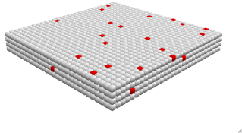
The Limits of Software
One layer, no hierarchy
2000 mini-columns
30 cells per mini-column
Up to 128 dendrite segments per cell
Up to 40 active synapses per segment
Thousands of potential synapses per segment
One millionth human cortex
50 msec per inference/training step (highly optimized)
30
128
2000 columns
40
We need HW for the usual reasons.
Speed
Power
Volume

Slide 59
Notes:
Matt

Slide 60
Start of supplemental material
Notes:
A more detailed view of Ray and Murray’s idea
Walk through slowly, end on CPGs (central pattern generators) Ray Guillery and Murray Sherman’s “efference copy”. I don’t know if this is true everywhere. But I like it. It is consistent with the idea that cortex is cortex. But it begs the question “How do you interpret this?” How do we understand these connections from a theoretical point of view.
It is easier to imagine M1 driving muscles, but how can mid and high level connections drive motor behavior?

Slide 61
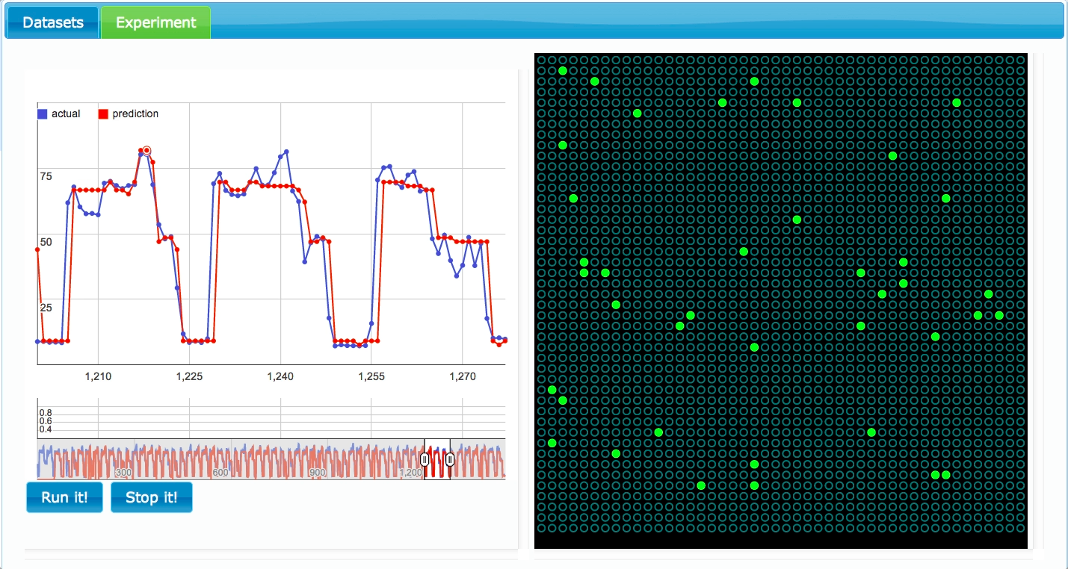

Slide 62
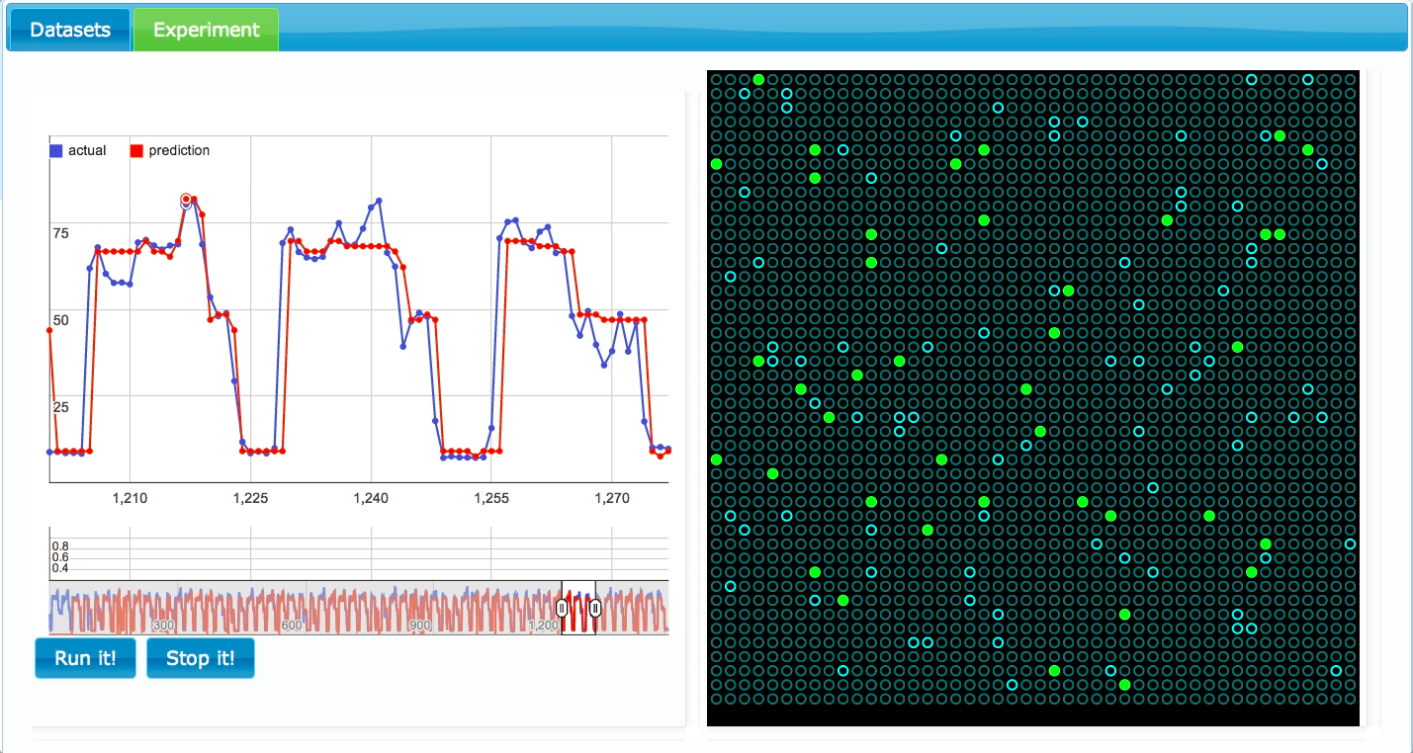

Slide 63
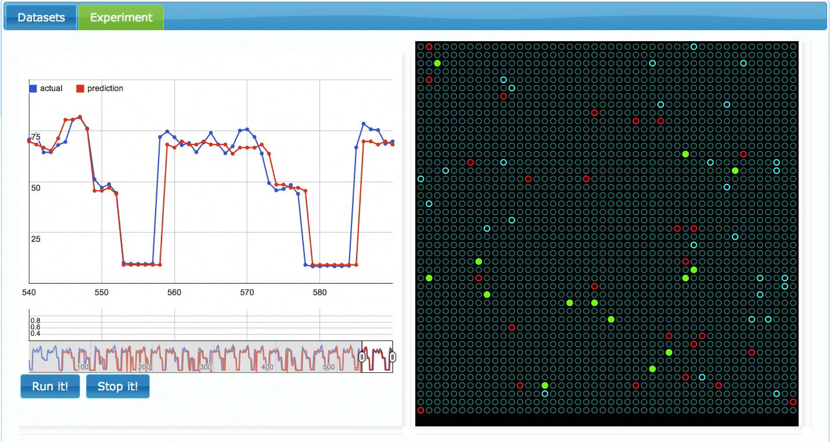

Slide 64
Requirements for Online learning
Train on every new input
If pattern does not repeat, forget it
If pattern repeats, reinforce it
Learning is the formation of connections
Connection permanence
unconnected
connected
0
0.2
1
Connection strength/weight is binary
Connection permanence is a scalar
Training changes permanence
If permanence > threshold then connected

Slide 65
“If you invent a breakthrough so computers can learn, that is worth 10 Microsofts”
Notes:
Matt

Slide 66
"If you invent a breakthrough so computers that learn that is worth 10 Micros
Machine Intelligence
What principles will we use to build intelligent machines?
What applications will drive adoption in the near and long term?
Notes:
Matt

Slide 67
Machine intelligence will be built on the principles of the neocortex
Flexible (universal learning machine)
Robust
If we knew how the neocortex worked, we would be in a race to build them.
Notes:
Matt

